Slide 1
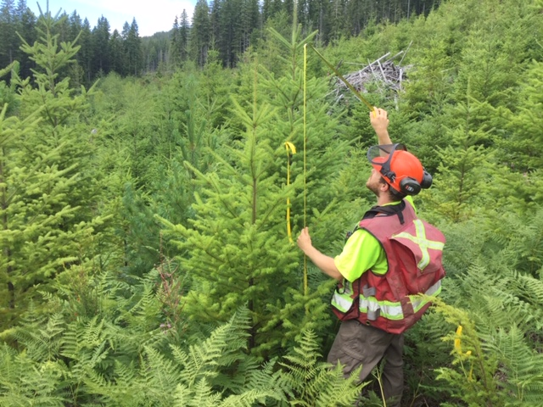
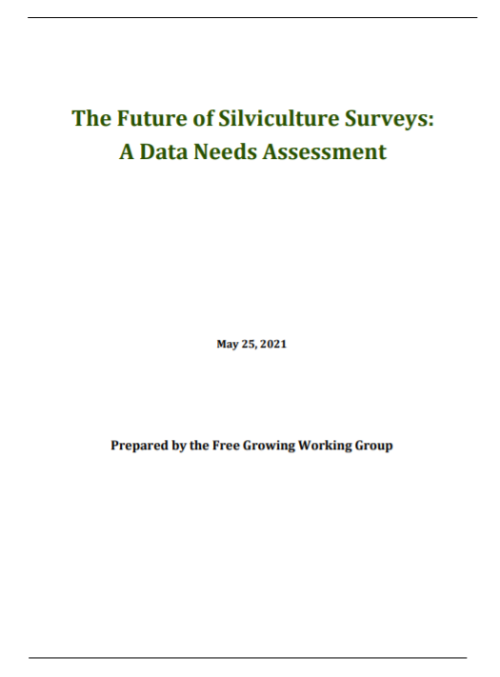

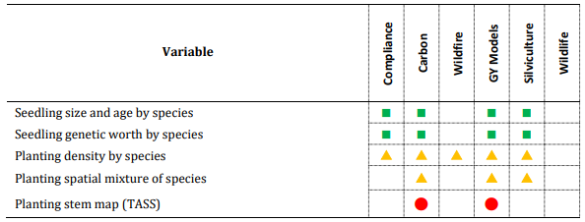
Free Growing
Working Group ISSC Update: November 24, 2021
3.2.2 Regeneration – Planting
Notes:
(…after REPRESSION DENSITY)
Taisa and I will co-present the work that this group has accomplished thus far.
The ’data needs assessment’…has really been where we’ve focussed time…and it has been useful in directing our current efforts (click)

Slide 2
Road map: Document Sharing
Distribution of Data Needs Assessment Paper to Industry and Government
Distribution of Supporting Documents: tools that identify the potential issues and pose solutions:
  Well Spaced
  TASS/Tipsy modelling
  Regeneration Assessment Options
  Current Modelling for TSR using RESULTS data
  Next Steps will
  Work toward developing ‘straw dog’ methods testing within a pilot, trial area…collaborating…feedback on FG framework and possible survey objectives
Notes:
plan to share some important work that we’ve done
The data needs assessment is a document that summarizes the important data elements collected during silv surveys that are deemed necessary and useful to other government program areas. If you recall …we engaged with wildlife, wildfire, Forest Analysis and Inventory, among others…
Additional documents we’ve completed include:
Documentation around the well spaced construct and its limitations…
Modelling 101-to highlight some of the key strengths and weaknesses of TASS and Tipsy
Brainstorming document that identifies options to consider as we re-think compliance and how we look to the future performance measures at the stand and landscape level
Also, the current methods for how FAIB uses RESULTS data inputs to generate managed stand yield curves.
The Data NEEDS paper will be shared with the ISSC by the end of next week…we plan to have Program Area leads look at the final draft first…then we’ll share this with the members along with these mentioned supporting docs!
What I’d like to ask this group to consider is to establish an ISSC sub-group interested in helping this process along, adding industry’s voice

Slide 3
Next Steps to Improve Free Growing
  SURVEY CHANGES NOW!
    Implementing changes to the silviculture survey system at Regeneration Delay and Free Growing
  PLANTING INFORMATION…we need it reported to RESULTS
  WELL SPACED CONSTRUCT…useful anymore, or not? What are the alternatives?
  FREE GROWING SURVEY TIMING and the Free Growing Declaration
  Longer term alignment with FOREST LANDSCAPE PLANNING
Notes:
NEXT STEPS TO IMPROVE FREE GROWING---Survey Changes NOW!:
positive steps forward linking RESULTS data to managed stand yield projections… Taisa will speak to this in more detail
mid term changes that will require more industry collaboration, more engagement and feedback are the following … this is the soft introduction to elements that are likely to pose challenges
PLANTING INFORMATION (CLICK)
We have identified, with FAIB, the need to drill down on planting information-FAIB uses this info!
If we can bring in information that industry already collects ie-spatial planting units, prescription details specifying mixtures or discrete patches, etc we can better model these stands
Tipsy is a blended, weighted average of individual species projections…TASS has the added benefit of growing mixed species stands
This is key…our reliance on managed stands to provide for the provincial timber supply is increasing!!
WELL SPACED TREE COUNTS (CLICK)
Well spaced and free growing tree counts are being carefully weighed for their value…
these ‘tallies’ take a lot of time in the field to collect….and provide information ONLY satisfying compliance with stocking standards
They have NO USE for FAIB modelling, NO USE in describing wildlife tree or stand attributes, NO USE carbon modelling, and NO USE informing success of any other non-timber objective
There is known subjectivity in the selection of well spaced trees and the results are not reproducible
FREE GROWING TIMING (CLICK)
The question here is when do we relieve an obligation?
If we keep a similar model where compliance is required at regen and free growing, we may need to carefully consider the timing of information collected from a forest health perspective especially (early benefit, late too)..stand dynamics
We could look at sliding our compliance survey toward regen only…and looking to link a ‘performance survey’ back to specific objectives that will…in theory ….be identified by various (CLICK) Forest Landscape Planning tables

Slide 4
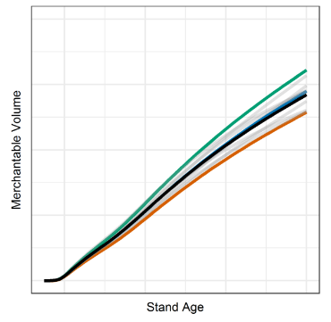
Linking Surveys to Timber Supply Review
  Primary goal of the Free Growing Working Group is to improve data collection to inform the Timber Supply Review Process
  SURVEY CHANGES NOW!
Notes:
The fundamental goal of the free growing working group is to improve the young stand inventory and incorporate changes that…(CLICK)
Improve data inputs to TSR…and consider other program area needs
What Taisa will speak about is predicated on our first Goal…to identify information that is:
Collected but likely not to the standard required
Collected to an adequate standard;
Collected to a higher standard than required; or
Not collected AT ALL
This transitions to quick wins…survey changes now!

